Slide 1
Advances Software Design: Final Task One
Team: Functor
Project: PowaFinance

Slide 2

Product description
Crisp app for tracking expenses and searching for investment opportunities
Team: Functor
Daniil Slobodeniuk — Project manager, Backend
Dmitry Egorov — Product manager, Android
Roman Dubinskiy — Business analyst, Frontend, Design
Features:
tracking daily expenses
purchasing financial assets via third-party investment platform
projecting expenses for the next quarter
top-notch financial news from news agency

Slide 3
Project resources
Project repository: https://github.com/SleeplessChallenger/PowaFinance
Repository current task materials: https://github.com/SleeplessChallenger/PowaFinance/tree/master/project_resources/asd/final-task-one-redone
Current presentation: https://docs.google.com/presentation/d/1Or3AycO_oSNPP8RCmydJQZ21Uh6eGN1P/edit?usp=sharing&ouid=110373371490262693970&rtpof=true&sd=true
Video for current presentation: https://drive.google.com/file/d/1GF79i3lTll8vpMn3oI5KQq_o50vTRbGT/view?usp=share_link

Slide 4

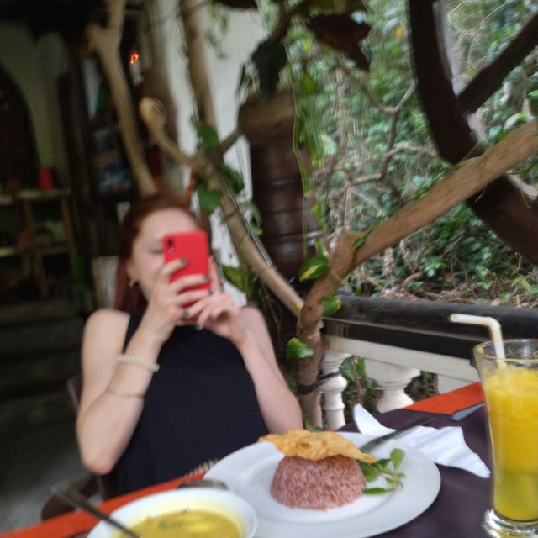
Personas
Pavel Kozlov
24 y.o, Works at Raiffeisen Bank Russia as Software Engineer. Kotlin/Java Backend Developer. Uses financial app without smart tracking features. Has desire to find out more info to manage finances smarter.
LinkedIn
Valentina
23 y.o.e. student from HSE. Works at VK as frontend developer. Interested in finances and want to know more about them.

Slide 5
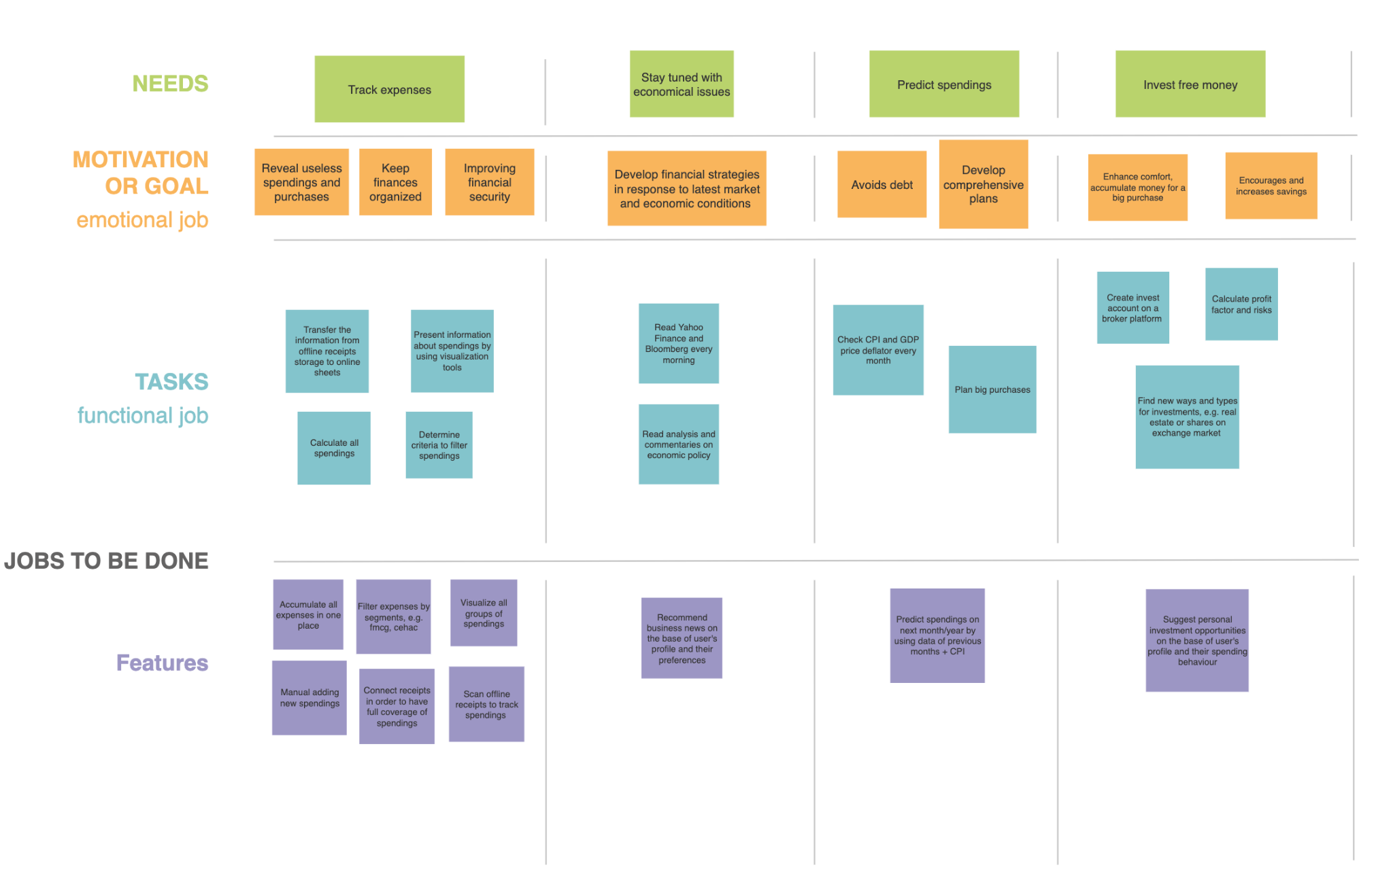
Story map
See in the repository: https://github.com/SleeplessChallenger/PowaFinance/tree/master/project_resources/asd/final-task-one-redone/story-map

Slide 6
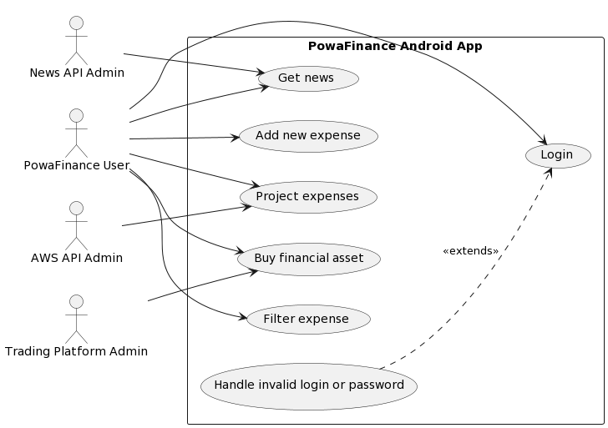
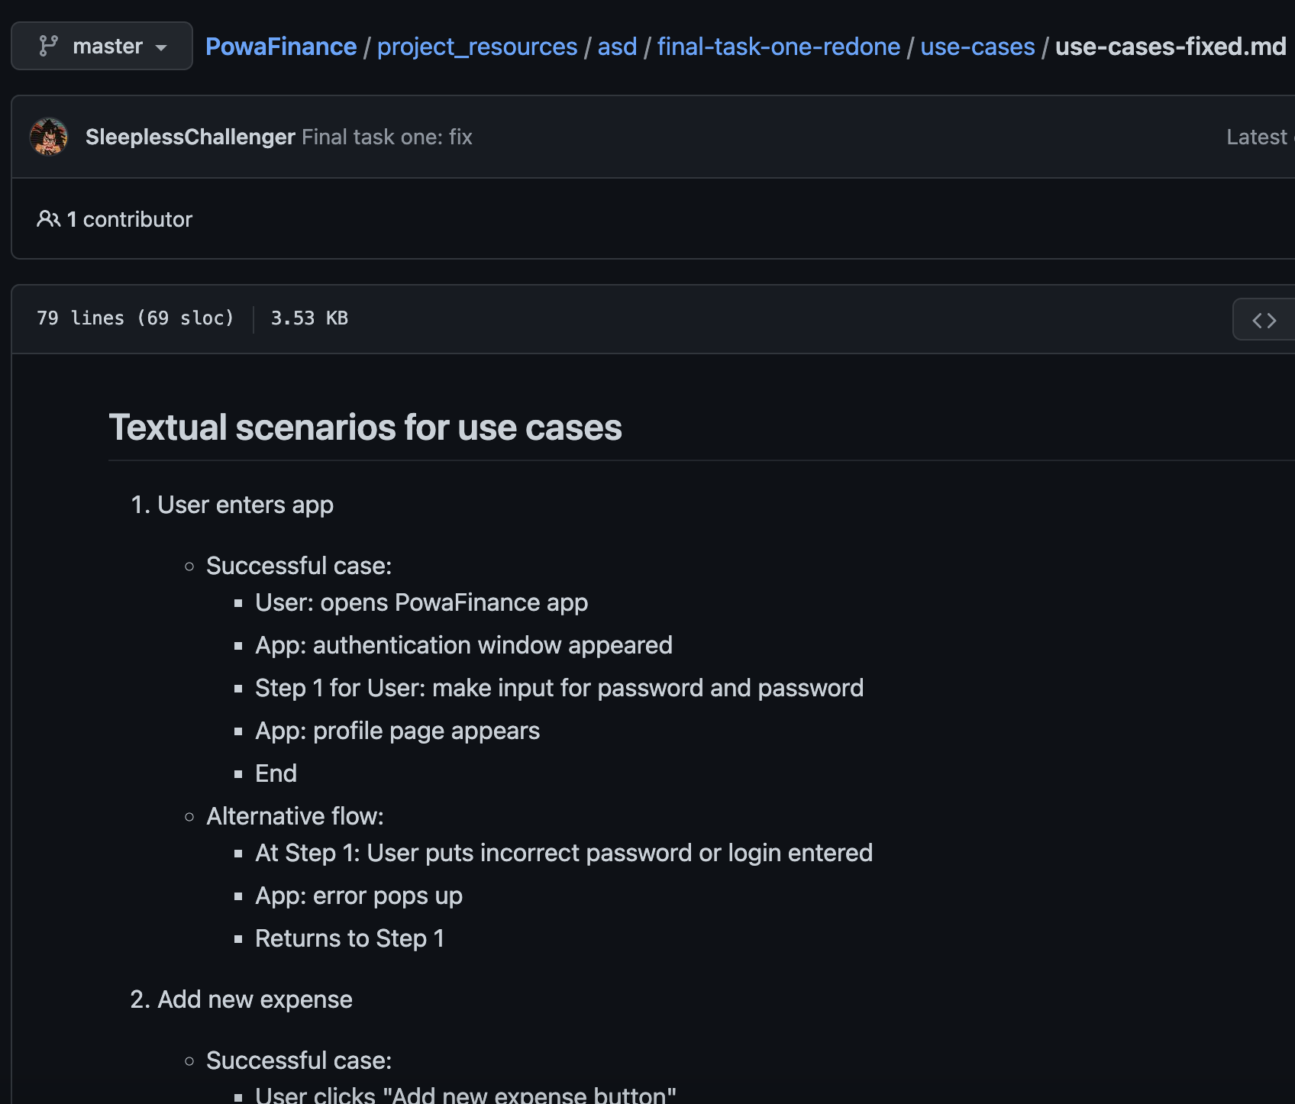
Use cases diagram
Use cases folder: https://github.com/SleeplessChallenger/PowaFinance/tree/master/project_resources/asd/final-task-one-redone/use-cases
Use cases textual description: https://github.com/SleeplessChallenger/PowaFinance/blob/master/project_resources/asd/final-task-one-redone/use-cases/use-cases-fixed.md

Slide 7
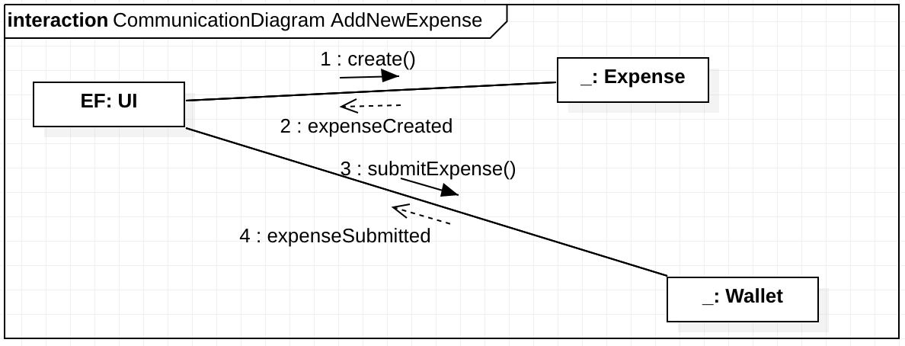
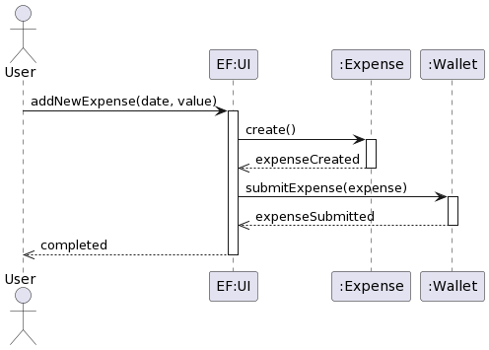
Interaction analysis
Candidate | Criteria | Stored Information | Operations
User | T
Expense | SAU | Date Value | Create
Wallet | SIUT | Expenses | Submit expense
See more: https://github.com/SleeplessChallenger/PowaFinance/tree/master/project_resources/asd/final-task-one-redone/sequence-diagrams
https://github.com/SleeplessChallenger/PowaFinance/tree/master/project_resources/asd/final-task-one-redone/communicaton-diagram

Slide 8
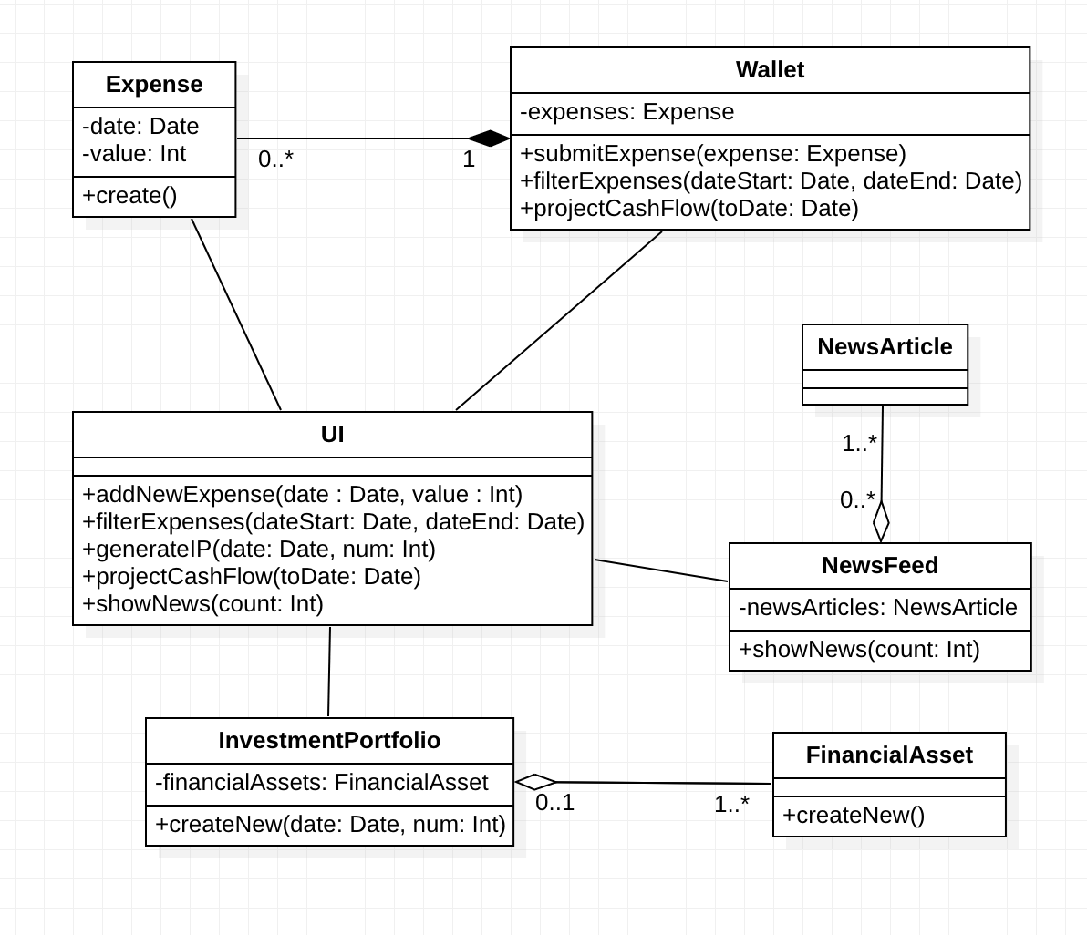
Final class diagram
See more: https://github.com/SleeplessChallenger/PowaFinance/blob/master/project_resources/asd/final-task-one-redone/final-class-diagram/finalClassDiagram.png

Slide 9
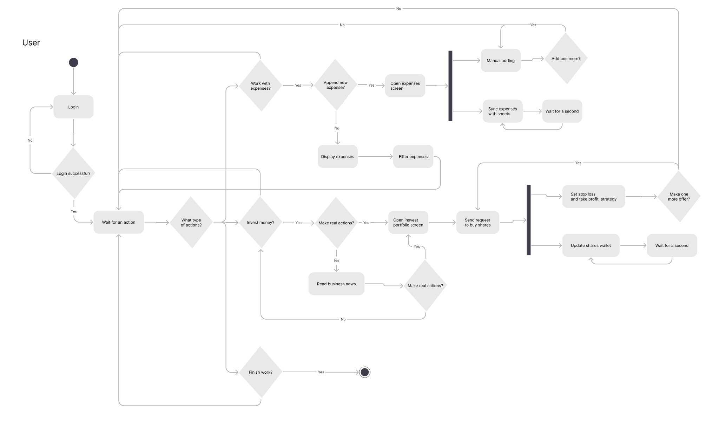
Detailed behavior
See more: https://github.com/SleeplessChallenger/PowaFinance/blob/master/project_resources/asd/final-task-one-redone/activity-diagram/behaviourDiagram.png

Slide 10
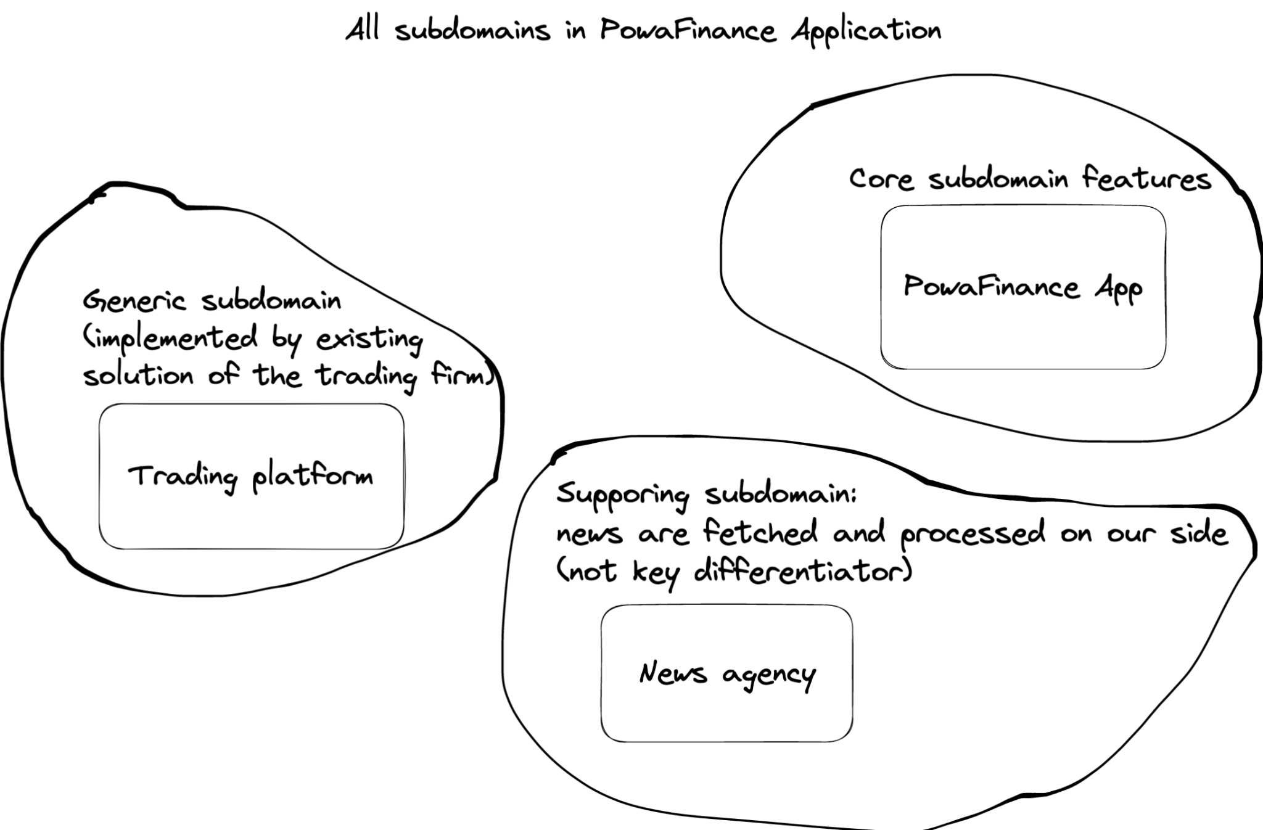
DDD - domain driven design
Separate by subdomain where:
Core subdomain: provide functionality for adding/observing expenses
Supporting subdomain: supply fresh news about financial sector - leverage News provider
Generic subdomain: integration with trading platform where user can buy financial assets
See more: https://microservices.io/patterns/decomposition/decompose-by-subdomain.html

Slide 11
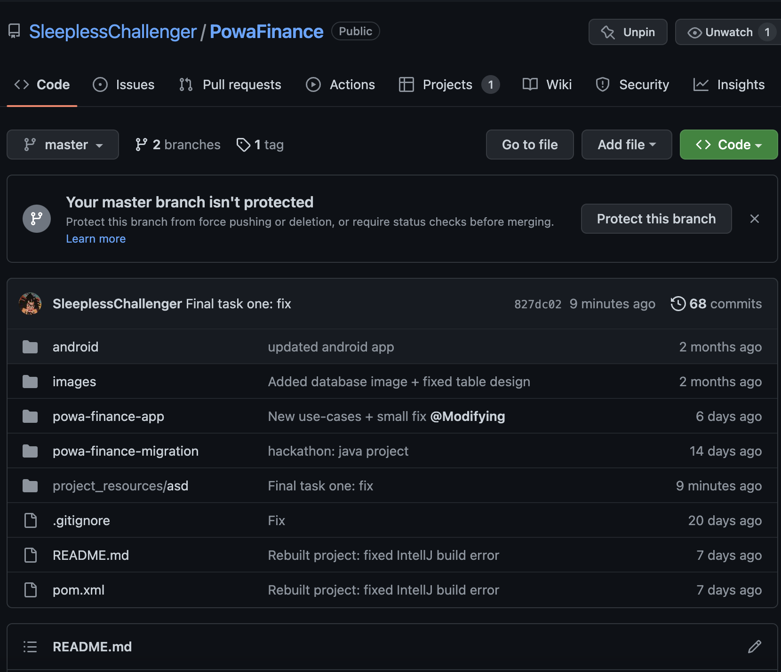
Repository structure
See more: https://github.com/SleeplessChallenger/PowaFinance/blob/master/project_resources/asd/final-task-one-redone/repository-structure/ProjectsBacklog.jpeg
In the repo you can observe the following structure:
project_resources/asd: all tasks for the topics that we covered for both modules
- final-task-one-redone: current task materials
powa-finance-app: fully-functioning SpringBoot app
powa-finance-migration: liquibase migration system which allows our app to keep various changes of the database
README.md: part of the app that documents all the links and has main features of the app described

Slide 12

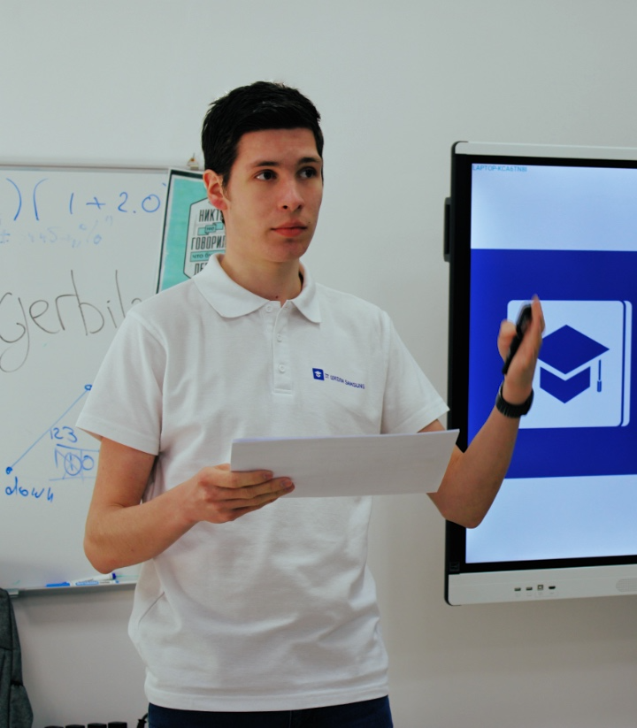

Team and roles
Daniil Slobodeniuk @SleeplessChallenger Resp. for DDD, UCs: See BN, Log in, Proj CF
Dmitry Egorov @dmitrijegorow Resp. for UCs: Add NE, Filter E, Gen IP
Roman Dubinskiy @rvdubinskiy Resp. for UCs: Buy FA, Gen IP, See BN

